Slide 1
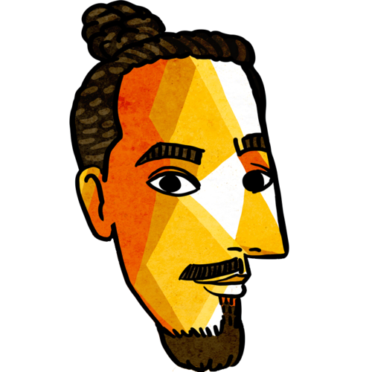
History & Current State
of P2P (& Cryptography)
By
Manfred Touron
✉
manfred.life
m@42.am
@moul

Slide 2
P2P

Slide 3
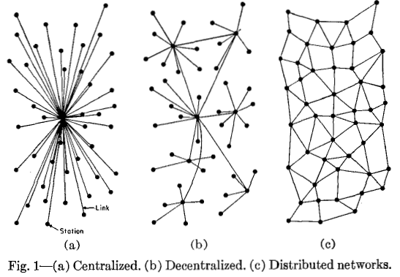
Centralized VS Decentralized VS Distributed

Slide 4
History

Slide 5
ARPANET allowed two remote computers to send and receive data packets.
Not self-organized, no content/context-based routing.

Slide 6
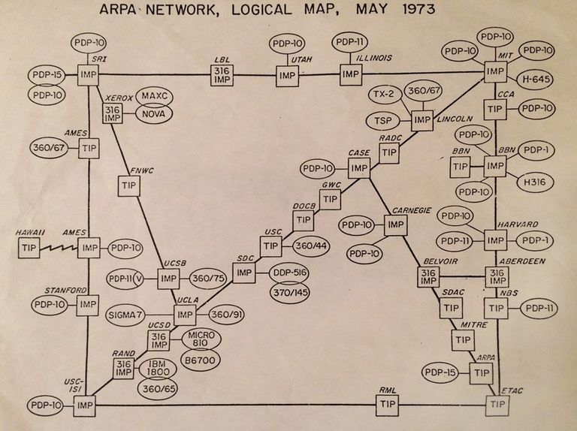
ARPANET
Advanced Research Projects Agency Network
1969-1989
First network to implement the TCP/IP protocol
Was operated only by the military
MYTH: was built as a system that would survive a nuclear attack

Slide 7
Usenet addressed many of those issues, continuing and evolving the idea of a free internet.

Slide 8
Usenet
Worldwide distributed discussion system
Established in 1980 by Tom Truscott and Jim Ellis
Developed from the general-purpose Unix-to-Unix Copy (UUCP) dial-up network architecture
Was the first Internet community, the launch of “World Wide Web” and Linux were announced there.
Threaded discussions, precursor to modern web forums
Popularized many terms such as "FAQ", "flame", Sockpuppet, and "spam".

Slide 9
The initial vision was for the internet to be similar to a P2P network
Tim Berners-Lee (Inventor of the World Wide Web)

Slide 10
Internet
Global system of interconnected computer networks
Reached 50 million users in 4 years (it took TV 13 years to reach this number, radio - 38 years)
Now has 4+ billion users, half of whom are Asian
First ever image uploaded to the Internet By Tim Berners-Lee, father of the World Wide Web

Slide 11
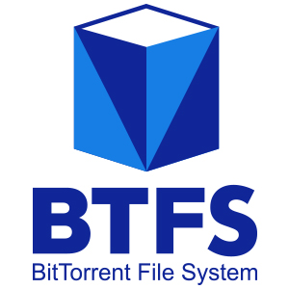
BitTorrent
Communication protocol for P2P file sharing
Reigned supreme in 2008, but is on steady decline since then
Facebook and Twitter use BitTorrent to distribute updates to their servers.
In 2019, launched BTFS (BitTorrent File System), a distributed storage network.
Usable by average-joe by the end of the year

Slide 12
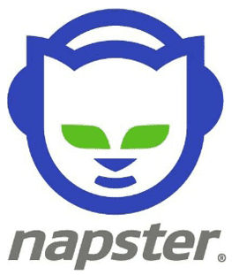
Napster
Peer-to-Peer MP3 sharing service
Founded in 1999 by Shawn Fanning and Sean Parker
Shut down by court order in 2001
Later, “Napster” became an online music store

Slide 13
The Pirate Bay
Online index of magnet links and torrent files
Founded in 2003 by Swedish think tank Piratbyrån
Found guilty of assisting in copyright infringement, TPB’s founders served short prison sentences

Slide 14
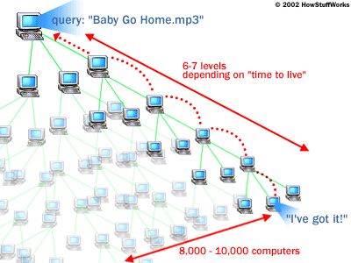
Gnutella
A peer-to-peer file sharing protocol
The first decentralized P2P network of its kind
Incepted in early 2000
Grew in popularity as a fully distributed alternative to Napster and other services that could be shut down by court order
“How Gnutella finds a song”, 2002

Slide 15
Blockchain
Decentralized, distributed and public digital ledger that is used to record transactions across many computers
It’s a growing list of records, called blocks, that are linked using cryptography
Bitcoin was the pioneer of blockchain technology
Blockchain can reduce 30% of banks’ infrastructure costs
Microsoft plans to use blockchain to develop decentralized digital IDs for people to verify their identity

Slide 16
IPFS
InterPlanetary File System
Launched by Protocol Labs in 2014
2016: libp2p: modular p2p networking stack
Decentralized, distributed, open-source
Could be seen as a single BitTorrent swarm, exchanging objects within one Git repository.
2017: Filecoin is an open-source cryptocurrency built on top of IPFS
Proof-of-{Work,Replication,Spacetime,...}

Slide 17
Sia
Decentralized cloud storage platform based on blockchain technology
Connects users who need file storage with hosts worldwide offering underutilized hard drive capacity.
To get paid, the storage host must submit a storage proof, made possible by using the hash tree (Merkle tree) technology, patented by Ralph Merkle in 1979.

Slide 18
Ethereum
Not only a cryptocurrency. It is rather a P2P financial infrastructure able to support any kind of currency design, if expressed as a collective Smart Contract (irreversible transaction defining the negotiation of a contract).
A platform for building and running applications which do not need to rely on trust and cannot be controlled by any central authority.
Was funded through crowdfunding
Grew 50 times since 2017
Its native currency is Ether
Unlike Bitcoin, Ethereum doesn’t have a cap on overall coins, but limits the number of coins that can be mined each year to 18 million per year
Whisper: Dapps communication
Notes:
A smart contract is a computer protocol intended to digitally facilitate, verify, or enforce the negotiation or performance of a contract. Smart contracts allow the performance of credible transactions without third parties. These transactions are trackable and irreversible.

Slide 19
Lightning Network
"Layer 2" payment protocol that operates on top of a blockchain-based cryptocurrency
Allows participants to transfer money to each other without having to make all their transactions public on the blockchain
Lightning requires a transaction malleability fix in the Layer 1 blockchain.
Malleability is a property of some cryptographic algorithms. An encryption algorithm is "malleable" if it is possible to transform a ciphertext into another ciphertext which decrypts to a related plaintext.

Slide 20
P2P has survived well into the 21st century
And the best is yet to come

Slide 21
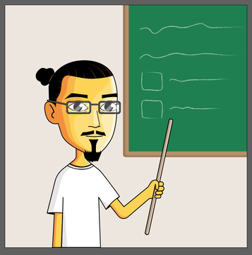
Any Questions?
Thank you, and feel free to contact me!
Manfred Touron
✉
manfred.life
m@42.am
@moul

